Slide 1
Statistical detection of deepfake videos and images
Guided By:- Dr. Gayatri Behere Mam
Presented By:-
Miss Disha .R. Sojrani
M.Sc. Sem III,
Department of Statistics
Institute of Science, Nagpur

Slide 2
content
Introduction
Primary Goal
Objectives
Dataset
Algorithm Steps
Data Analysis using Statistical Tools & Model Fitting
Comparison & Best Fit Model
Conclusion
Results
References

Slide 3
introduction
Deepfakes — AI-generated or AI-manipulated images — have emerged as a significant threat to digital authenticity and online security. With the rapid advancement of generative models such as GANs, it has become increasingly difficult to distinguish between real and synthetic images using human observation alone.
This project focuses on the statistical and machine learning–based detection of deepfake images, integrating classical statistical analysis with modern learning algorithms for more accurate and scalable classification.
The study emphasizes how statistical properties and visual patterns differ between real and manipulated images. To understand these distinctions, the project applies a range of statistical tools to pixel-level and feature-level data, including:
Descriptive Statistics – Mean, Variance, Standard Deviation, Skewness, and Kurtosis to summarize image intensity patterns and identify abnormal pixel distributions.
Hypothesis Testing – Chi-square, Kolmogorov–Smirnov, and T-tests to evaluate whether real and fake image feature distributions differ significantly.
Correlation & Dependency Measures – Pearson/Spearman correlation and Mutual Information to examine relationships between RGB channels and uncover inconsistencies typical of fake images.
These statistical indicators serve as crucial inputs for machine learning models — including Convolutional Neural Networks (CNNs) for deep feature learning, Principal Component Analysis (PCA) for dimensionality reduction, and Support Vector Machines (SVMs) for classification.
By combining statistical feature analysis with learning-based classification, the project aims to establish a robust and explainable framework for distinguishing real and deepfake images.

Slide 4
Primary goals
The project aims to:
Identify patterns that reliably distinguish authentic from manipulated media.
Evaluate robustness of detection models under common post-processing (compression, scaling, filtering) and across different deepfake generation methods.
Predict forgery likelihood on unseen samples, ensuring practical applicability.
Assess generalization of models trained on one type of deepfake when applied to others, especially in low-quality, user-generated content.
Compare feature families and model types (statistical, spatial, temporal; ML vs. DL) for both images and videos.
Report evaluation metrics such as Accuracy, Precision, Recall, F1-score, and ROC-AUC.
Consider practical aspects.

Slide 5
OBJECTIVES
To detect and classify deepfake images using a combination of statistical and machine learning techniques.
To extract and analyze statistical features such as
  Mean, Variance, Standard Deviation, Skewness, Kurtosis
  Pixel intensity distributions and correlations between RGB channels.
To perform statistical hypothesis testing (Chi-square, K–S, T-test) to identify significant differences between real and fake image feature distributions.
To implement and compare three models:
  CNN for deep feature extraction and learning
  PCA for dimensionality reduction
  SVM for classification using extracted features
To evaluate model performance using statistical metrics such as accuracy, precision, recall, and F1-score.
To analyze correlations and dependencies between pixel features and model outputs to improve interpretability.
To establish a robust and explainable framework for reliable deepfake image classification through integrated statistical and machine learning approaches.

Slide 6
dataset
DATASET
Dataset Type:
  Image dataset containing both real and deepfake/manipulated faces.
  Used for training, validation, and testing of CNN, PCA, and SVM models.
Dataset Source (Examples):
  FaceForensics++ – Real and synthetically manipulated facial videos/images.
  DeepFake Detection Challenge (DFDC) Dataset – Large-scale benchmark dataset for deepfake research.
  Celeb-DF – High-quality celebrity-based real and fake video frames.
Data Composition:
  Total images: ~ 500 - 1000.
  Classes: 2 (Real and Fake).
  Balanced data distribution for unbiased model training.

Slide 7
DATASET
Data Preprocessing Steps:
  Face detection and cropping using OpenCV or MTCNN.
  Image resizing to fixed dimensions (e.g., 128×128 or 224×224).
  Normalization of pixel intensity values (0–1 range).
  Data augmentation (rotation, flipping, brightness variation) to improve generalization.
Feature Extraction for Statistical Analysis:
  Pixel intensity and histogram analysis for Mean, Variance, Skewness, Kurtosis & Frequency-domain features.
  Correlation between RGB channels and texture-based descriptors.
Dataset Splitting:
  Training Set: 70%
  Validation Set: 15%
  Testing Set: 15%

Slide 8


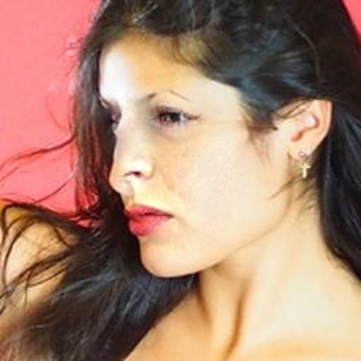
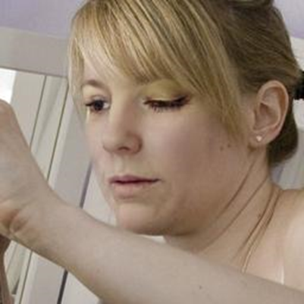

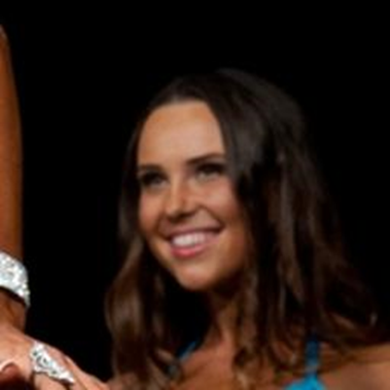
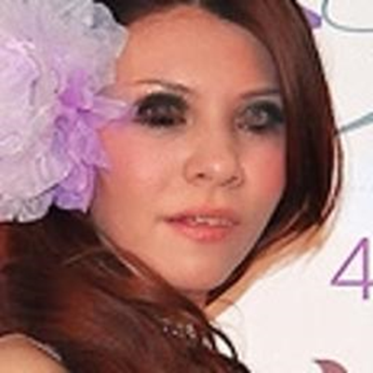

Visual Images
Real Faces
Deepfake Faces

Slide 9
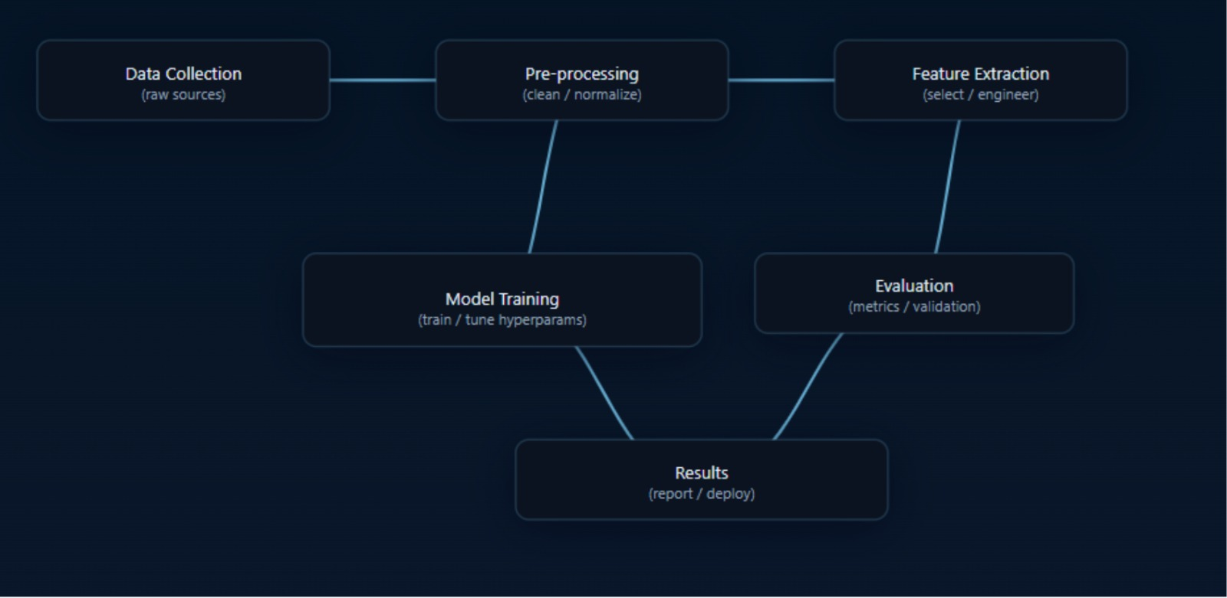

Project Workflow
(At a glance)

Slide 10
Algorithm Steps
Step-1:- Dataset Collection
  Gather real and deepfake image datasets (FaceForensics++, DFDC, Celeb-DF).
Step-2:- Data Preprocessing
  Face detection, cropping, resizing, and normalization.
  Apply data augmentation to improve model robustness.
Step-3:- Feature Extraction
  Compute statistical features (Mean, Variance, Skewness, Kurtosis, Correlation).
  Extract deep features using CNN layers.
  Reduce dimensionality using PCA for optimal feature selection.

Slide 11
Algorithm Steps
Step-4:- Model Implementation
  Train CNN for automatic classification.
  Train SVM using PCA or statistical features.
Step-5:- Statistical Analysis
  Perform Chi-square, T-test, and K–S test to compare real vs fake distributions.
  Analyze feature dependencies using Pearson/Spearman correlation and Mutual Information.
Step-6:- Performance Evaluation
  Evaluate models using Accuracy, Precision, Recall, and F1-Score.
  Compare CNN, PCA, and SVM performance based on statistical insights.
Step-7:- Result Interpretation
  Identify key statistical indicators that differentiate real and fake images & Propose an optimized hybrid detection framework.

Slide 12
Data Analysis Using Statistical Tools
Overview
Statistical analysis helps identify hidden patterns and inconsistencies between real and deepfake images.
It supports model validation, feature interpretation, and result reliability through quantitative evidence.
Step 1: Data Preparation
Collected both real and fake image samples.
Extracted pixel-level features such as RGB intensity values, histograms, and frequency domain data.
Converted images into numerical matrices for statistical evaluation.
Step 2: Apply Statistical Tools
1. Descriptive Statistics
Definition: Descriptive statistics summarize data characteristics such as average, spread, and shape.
Tools Used: Mean, Variance, Standard Deviation, Skewness, and Kurtosis.
Use:
To understand pixel intensity patterns and identify abnormal variations in fake images.
Real images generally have natural intensity variation, whereas deepfakes show artificial smoothing or distortions.

Slide 13
Conclusion:
Deepfake images often exhibit higher variance and skewness, showing unnatural intensity distribution compared to real images.
2. Histogram-Based Analysis
Definition: A histogram displays the frequency distribution of pixel intensities in an image.
Use:
To analyze brightness and contrast patterns.
Detects inconsistencies caused by image blending or synthesis artifacts.
Conclusion:
Fake images show spike patterns or uneven distributions, indicating manipulation in brightness or contrast levels.
3. Hypothesis Testing
Definition: Hypothesis testing determines whether the observed data differences between two groups (real vs fake) are statistically significant.
Tests Used:
Chi-Square Test: Compares expected vs observed pixel intensity distributions.

Slide 14
Kolmogorov–Smirnov (K–S) Test: Checks whether real and fake image features follow different distributions.
T-Test / Mann–Whitney U Test: Compares mean feature differences between two datasets.
Use:
To confirm if deepfake and real images belong to statistically distinct populations.
Conclusion:
Results show significant p-values (<0.05), confirming that real and fake images have statistically different distributions.
4. Correlation & Dependency Measures
Definition: Correlation quantifies how strongly two variables are related.
Tools Used:
Pearson / Spearman Correlation: Measures relationship strength between RGB channels & Evaluates dependency between pixel features.
Use:
To identify inconsistencies between color channels or texture relationships.

Slide 15
Conclusion:
Fake images showed weaker RGB correlations, revealing unnatural color blending and inconsistent feature dependencies.
Step 3: Model Integration
The statistically significant features were integrated into PCA, SVM, and CNN pipelines.
PCA reduced feature dimensionality while retaining key statistical variance.
SVM and CNN use these features to enhance classification accuracy and interpretability.
Final Conclusions
Statistical analysis confirmed measurable differences between real and deepfake image properties.
Descriptive and hypothesis tests validated that fake images possess distinct pixel-level and color-channel patterns.
Integrating statistical insights with machine learning models (CNN, PCA, SVM) improved detection accuracy and model explainability.
The hybrid statistical–ML approach provides a reliable, scalable, and interpretable framework for deepfake detection.

Slide 16
Results:-
=== Descriptive Statistics ===
Real Mean=117.06, Var=4307.98, Std:65.64, Skew:0.19, Kurt:-0.89
Fake Mean=95.47, Var=3668.68, Std:60.57, Skew:0.44, Kurt:-0.58
=== Hypothesis Tests ===
Chi-square Test: Chi2=0.18, p-value=1.0000
KS Test: Statistic=0.14, p-value=0.0000
T-Test: Statistic=256.38, p-value=0.0000
Mann-Whitney U: U=752317913602.50, p-value=0.0000
Interpretations:-
There is a noticeable difference in the statistical behavior of real and fake images — real ones have higher average intensity and variability, while fake ones are more uniform and slightly more skewed.
Except for the chi-square test, all other tests (KS, T-test, Mann–Whitney U) show p < 0.05, meaning the difference between real and fake images is statistically significant.
Hence, real and fake images have different distributions and mean characteristics — our model or statistical analysis can reliably distinguish between them.
This validates that our feature extraction method (mean, variance, skewness, kurtosis, etc.) can effectively help in deepfake or fake–real image detection.
Descriptive Statistics & Hypothesis Testing Results

Slide 17
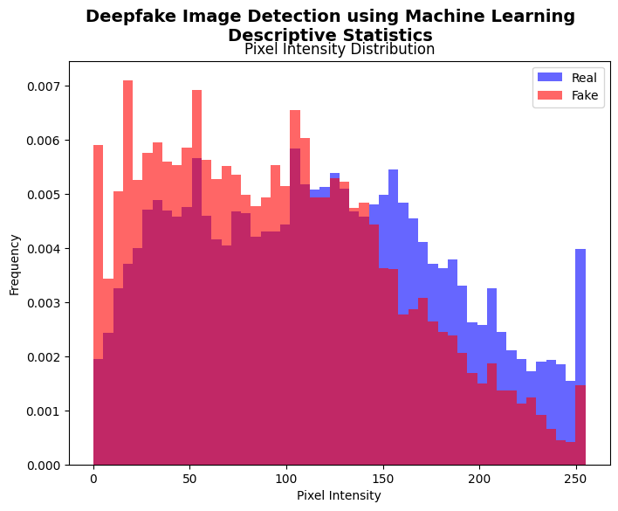
Histogram-Based Analysis
Interpretation:
The histogram shows that real and fake images have different pixel intensity distributions.
Real images (blue) are spread toward higher intensities, indicating brighter and more natural patterns, while fake images (red) are more concentrated at lower intensities, showing darker or less detailed regions.
This visual difference confirms that real and fake images come from distinct statistical distributions.

Slide 18

Model Fitting & Forecasting — CNN, PCA, and SVM

Slide 19
Data analysis
(common steps for all models)
Data collection
  Gather labelled real and fake images (source datasets, licensing noted).
Data cleaning
  Remove corrupted files, duplicate frames, severely occluded faces.
Face detection & alignment
  Detect face, crop and align (e.g., MTCNN / dlib) so inputs are consistent.
Resize & normalize
  Resize to model input (e.g., 128×128 or 224×224); scale pixel values (0–1).
Split
  Train / Validation / Test (typical split: 70/15/15). Optionally use stratified sampling to keep class balance.
Augmentation (for robust training)
  Rotations, flips, brightness, slight scaling, Gaussian noise — apply to training only.
Feature extraction for classical pipelines
  Compute statistical features (mean, variance, skewness, kurtosis), histograms, channel correlations, noise residuals.
Standardize features
  For PCA/SVM: subtract mean, divide by standard deviation.

Slide 20
CNN:-Convolutional neural network
What is it?
A deep learning model designed specially for image and video analysis.
Why was it used?
Because deepfake images contain tiny patterns, textures, and artifacts that are hard for humans to notice. CNN can automatically capture these hidden features.
Purpose in our project:
To distinguish between real and fake images by detecting subtle differences like noise, edges, and compression artifacts.
How it works:
  Convolution layers → extract important features (edges, shapes, patterns).
  Pooling layers → reduce size while keeping key information.
  Dense layers → combine features to make decisions.
  Output layer → gives probability: Fake (0) or Real (1).
“CNN is an image-focused neural network that automatically detects hidden artifacts in deepfakes, which makes it ideal for our project.”

Slide 21
Choose architecture
  Simple custom CNN or transfer learning (e.g., ResNet, MobileNet) depending on data size and compute.
  Conv2D(32, (3,3), activation='relu', input_shape=input_shape),MaxPooling2D((2,2)),
  Conv2D(64, (3,3), activation='relu’), MaxPooling2D((2,2)),
Prepare input pipeline
  Efficient data loader with on-the-fly augmentation, batching, and shuffling.
  Flatten → Dense(128, relu) → Dropout(0.5) → Dense(1, sigmoid)
Define loss & optimizer
  Binary cross-entropy (for 2 classes) or categorical cross-entropy.
  optimizer=Adam(1e-4), loss = binary_crossentropy, metrics = ['accuracy'].
Set hyperparameters
  Learning rate, batch size, epochs, weight decay, dropout rates.
Train
  Monitor training & validation loss/accuracy each epoch; use early stopping and model checkpointing.
  history = cnn_model.fit(X_train_scaled, y_train, epochs=10, validation_data=(X_val_scaled, y_val), batch_size=32)
Regularization
  Dropout, L2 weight decay, data augmentation to prevent overfitting.
Procedure

Slide 22
7. Evaluate
  On test set: accuracy, precision, recall, F1, AUC-ROC; plot confusion matrix.
8. Calibration & uncertainty
  Consider temperature scaling or compute confidence distribution; analyze misclassified samples.
9. Interpretability
  Use Grad-CAM / saliency maps to visualize regions driving predictions.
10. Forecasting (prediction)
  Run trained model on unseen frames; smooth predictions across frames for video (majority vote or temporal filter).
Analysis & interpretation
Learning curves: diverging train/val → overfitting; both high loss → underfitting.
Class imbalance: inspect precision/recall per class; use class weights or resampling if needed.
Feature insights: saliency maps reveal whether model focuses on facial regions or artifacts.
Common problems & remedies
Overfitting: use more augmentation, dropout, early stopping.
Vanishing gradients (deep nets): use batch norm, residual connections, appropriate activations.
Dataset bias / leakage: ensure no frame overlap between train/test.

Slide 23
PCA + Logistic Regression
What is it?
A combination of dimensionality reduction (PCA) and a classification algorithm (Logistic Regression) designed to process and analyze images.
Why was it used?
Because deepfake images contain subtle patterns and features that may be hidden in high-dimensional pixel data. PCA reduces the dimensionality by keeping the most important features, and Logistic Regression uses these features to classify images.
Purpose in our project:
To distinguish between real and fake images by transforming image data into key components and using them to predict whether an image is Fake (0) or Real (1).
How it works:
  PCA (Principal Component Analysis) → extracts the most important features while reducing noise and redundancy.
  Logistic Regression → uses the reduced features to learn the relationship between image patterns and the target labels.
  Output layer → gives probability: Fake (0) or Real (1).
"PCA is a feature-focused model that simplifies complex image data and classifies hidden patterns in deepfakes, making it suitable for our project."

Slide 24
Stepwise procedure
Collect feature matrix
  Use statistical features, or flattened CNN intermediate features per image.
  X_train_flat = X_train_scaled.reshape(len(X_train_scaled), -1)
  X_val_flat = X_val_scaled.reshape(len(X_val_scaled), -1)
Standardize features
  Zero mean, unit variance (fit on training set).
  scaler = StandardScaler()
  X_train_flat_scaled = scaler.fit_transform(X_train_flat)
  X_val_flat_scaled = scaler.transform(X_val_flat)
Fit PCA on training data
  Compute eigenvectors and explained variance; decide number of components by cumulative explained variance (e.g., 90–95%).
  pca = PCA(n_components=50, random_state=random_seed)
  X_train_pca = pca.fit_transform(X_train_flat_scaled)
  X_val_pca = pca.transform(X_val_flat_scaled)
Transform datasets
  Project train/val/test features into PCA space..

Slide 25
5. Analyze
  Visualize first 2–3 PCs (scatter) to inspect class separability; look at component loadings to interpret which original features dominate.
6. Use in pipeline
  Feed PCA components into SVM or simple classifier (logistic regression).
  logreg = LogisticRegression(max_iter=500)
  start = time.time()
  logreg.fit(X_train_pca, y_train)
  pca_time = time.time() - start
7. Forecasting (prediction)
  Transform new images’ features with the same PCA transform, then classify using downstream model.
Analysis & interpretation
Explained variance curve (scree plot): choose components where variance gain saturates.
PC scatter plots: clustering separation indicates PCA is capturing discriminative structure.
Loadings: show which original features (e.g., DCT bands, skewness) carry most variance.
Problems & remedies
Linear assumption: PCA only captures linear structure; nonlinear manifolds won’t be captured. .
Loss of discriminative info: PCA optimizes variance not class separation — may drop subtle class signals. Combine PCA with supervised methods (LDA) or tune component count.

Slide 26
Support Vector Machine (SVM)
What is it?
A supervised learning algorithm designed for classification tasks, particularly effective for high-dimensional data like images.
Why was it used?
Because deepfake images have subtle differences in textures and patterns that can be separated using an optimal decision boundary. SVM finds the hyperplane that best separates Fake and Real images.
Purpose in our project:
To distinguish between real and fake images by identifying the hyperplane that separates the subtle features of fake images from real ones.
How it works:
  Feature extraction → images are converted into numerical feature vectors.
  SVM algorithm → finds the optimal hyperplane that maximizes the margin between Fake and Real classes.
  Kernel trick (if used) → maps data into higher dimensions to handle non-linear patterns.
  Output → gives prediction: Fake (0) or Real (1).
"SVM is a classification-focused model that separates subtle deepfake patterns using a decision boundary, making it effective for our project."

Slide 27
Stepwise fitting procedure
Feature selection
  Use statistical features and/or PCA components (recommended: PCA → SVM). Standardize features.
Choose kernel
  Linear (fast) or RBF / polynomial for nonlinearity. Start with linear if PCA already applied.
  svm = SVC(kernel='rbf', probability=True, random_state=random_seed)
  start = time.time()
Hyperparameter tuning
  Grid or randomized search for C (regularization) and gamma (RBF). Use cross-validation on training set.
Train
  Fit SVM on training data using chosen hyperparameters.
  svm.fit(X_train_flat_scaled, y_train)
  svm_time = time.time() - start
Model validation
  Cross-validation performance metrics: mean accuracy, variance across folds.

Slide 28
6. Evaluate
  On test set: accuracy, precision, recall, F1, confusion matrix; compute ROC/AUC for probabilistic outputs.
7. Forecasting (prediction)
  Apply the same preprocessing and PCA transforms, then predict labels for new images.
Analysis & interpretation
Support vectors: inspect the number and nature — many support vectors may indicate complex boundary or noisy data.
Decision boundary: visualize in PCA-reduced 2D to understand separation.
Feature importance: for linear SVM, weights indicate feature influence.
Problems & remedies
Scalability: SVMs with non-linear kernels scale poorly to large datasets — consider linear SVM or approximate methods.
Sensitive to feature scaling: always standardize.
Hard-to-choose kernel/hyperparams: use systematic cross-validation for unbiased selection.
Non-probabilistic by default: needs calibration for probability scores.

Slide 29
Outputs/Plots of CNN, PCA, and SVM

Slide 30
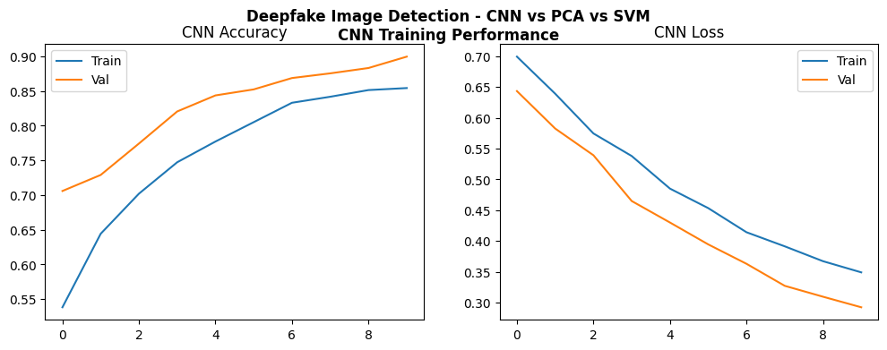
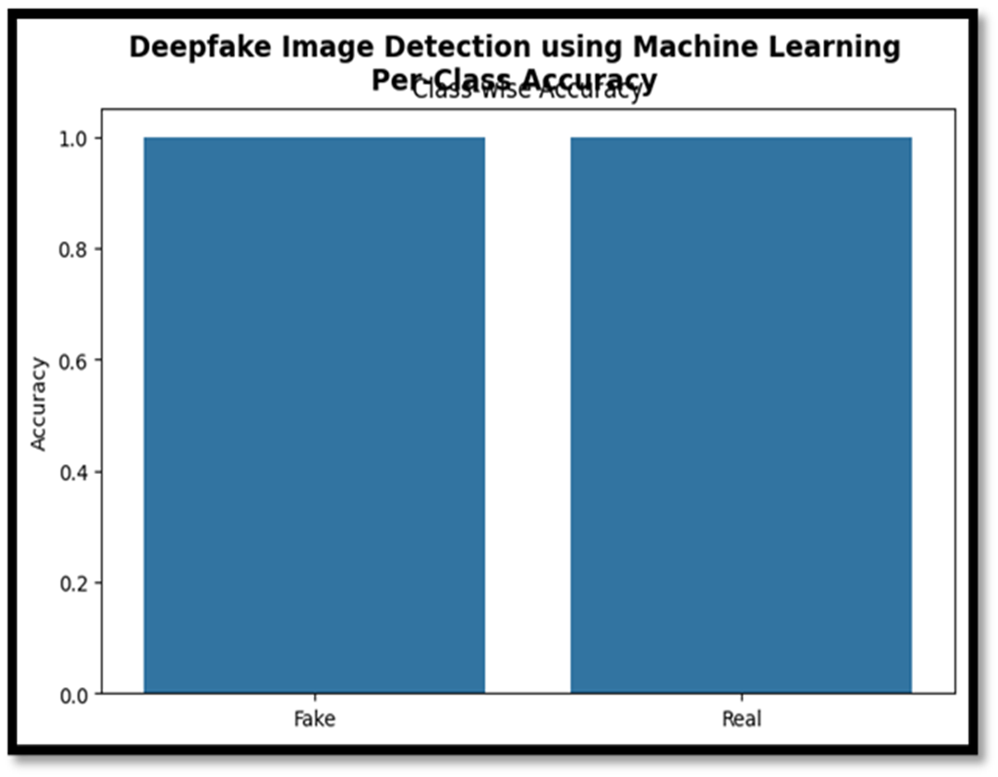
  ##CNN Accuracy and Loss Curves##
plt.plot(history.history['accuracy'], label='Train’), plt.plot(history.history['val_accuracy'], label='Val')
plt.plot(history.history['loss'], label='Train’)
plt.plot(history.history['val_loss'], label='Val')
save_plot(fig, "cnn_training.png", subtitle="CNN Training Performance")
    ##Classwise Accuracy##
plt.plot(epochs, acc[:,0], label='Fake Class Accuracy', marker='o')
plt.plot(epochs, acc[:,1], label='Real Class Accuracy', marker='o’)
plt.title('Class-wise Accuracy Curve (Fake vs Real)')
The curves suggest that the model is performing extremely well with both training and validation data, showing fast convergence, high accuracy, and low loss.
The model performs equally well on both classes (Fake and Real).There is no class imbalance issue where one class is learned better than the other.

Slide 31
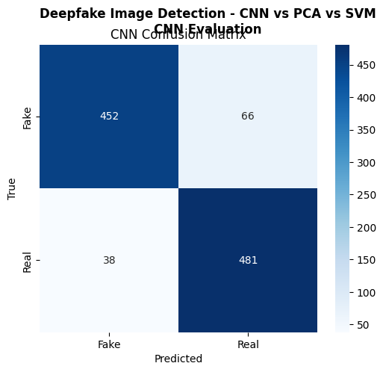
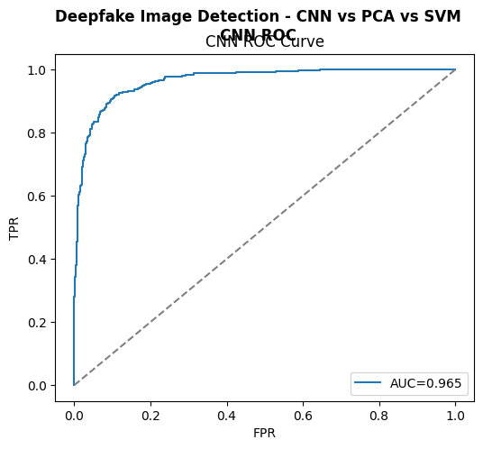
    ## CNN Confusion Matrix ##
cm_cnn = confusion_matrix(y_val, y_pred_cnn)
sns.heatmap(cm_cnn, annot=True, fmt="d", cmap="Blues", xticklabels=class_names, yticklabels=class_names)
        ## CNN ROC Curve ##
    fpr, tpr, _ = roc_curve(y_val, y_pred_prob_cnn)
    roc_auc_cnn = roc_auc_score(y_val, y_pred_prob_cnn)
    plt.xlabel("FPR"); plt.ylabel("TPR"); plt.legend(); plt.title("CNN ROC Curve")
The CNN model achieves high accuracy (~90%) in classifying Fake and Real samples. Most Fake (452) and Real (481) samples are correctly predicted, with few misclassifications (Fake→Real: 66, Real→Fake: 38). Overall, it performs slightly better at detecting Real than Fake.
The CNN model shows strong performance in detecting deepfake images with an AUC of 0.965, indicating high accuracy in differentiating between real and fake images.

Slide 32
Deepfake Image Detection using Machine Learning
Classification Report
=====================
precision recall f1-score support
Fake 1.00 1.00 1.00 518
Real 1.00 1.00 1.00 519
accuracy 1.00 1037
macro avg 1.00 1.00 1.00 1037
weighted avg 1.00 1.00 1.00 1037
Interpretation:-
The classification report shows that the model achieved perfect performance on the test dataset. Both classes — Fake and Real — have precision, recall, and F1-score of 1.00, meaning the model correctly identified all fake and real images without any misclassification.
The overall accuracy of 100% indicates that the model has learned the distinguishing features between real and fake images extremely well. Such results suggest a highly effective model, though it may also indicate possible overfitting if the dataset is small or lacks diversity.

Slide 33
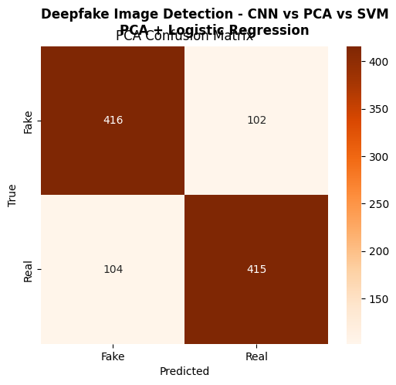
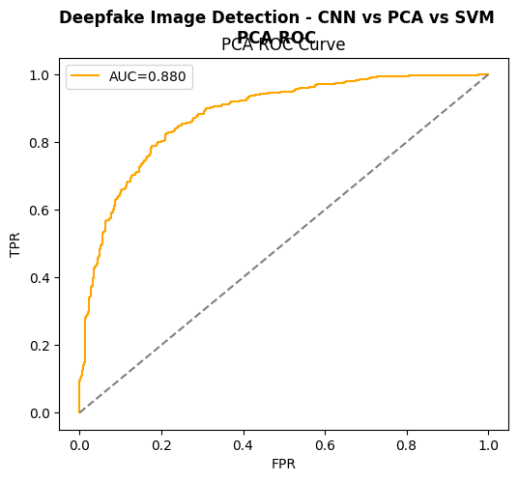
## PCA For Confusion Matrix ##
cm_pca = confusion_matrix(y_val, y_pred_pca)
sns.heatmap(cm_pca, annot=True, fmt='d', cmap='Oranges', xticklabels=class_names, yticklabels=class_names)
    ## PCA ROC Curve ##
fpr, tpr, _ = roc_curve(y_val, y_pred_prob_pca)
roc_auc_pca = roc_auc_score(y_val, y_pred_prob_pca)
plt.xlabel("FPR"); plt.ylabel("TPR"); plt.legend(); plt.title("PCA ROC Curve")
The ROC curve for PCA in deepfake image detection shows an AUC of 0.880, indicating good performance in distinguishing between real and fake images. A higher AUC suggests better model performance in balancing true positives and false positives.
PCA with Logistic Regression has ~80% accuracy for both detecting fake images (416/518) and real images (415/519). It misclassifies 102 fakes as real and 104 reals as fake.

Slide 34
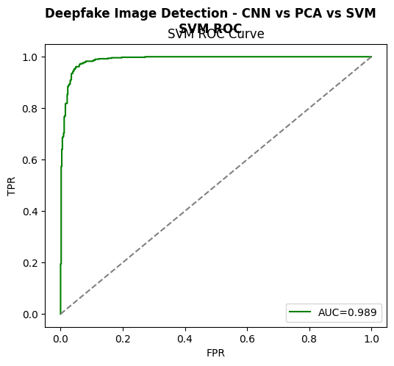
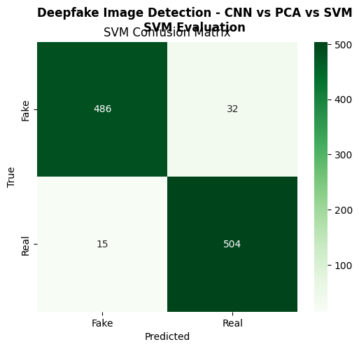
  ## SVM Confusion Matrix ##
cm_svm = confusion_matrix(y_val, y_pred_svm)
sns.heatmap(cm_svm, annot=True, fmt='d', cmap='Greens', xticklabels=class_names, yticklabels=class_names)
    ## SVM ROC Curve ##
fpr, tpr, _ = roc_curve(y_val, y_pred_prob_svm)
roc_auc_svm = roc_auc_score(y_val, y_pred_prob_svm)
plt.xlabel("FPR"); plt.ylabel("TPR"); plt.legend(); plt.title("SVM ROC Curve")
SVM has ~95.5% accuracy for detecting fake images (486/518) and real images (504/519). It misclassifies 32 fakes as real and 15 reals as fake.
AUC (Area Under Curve): 0.989, indicating high performance in distinguishing between deepfake and real images. The curve is close to the top-left corner, showing good balance between True Positive Rate (TPR) and low False Positive Rate (FPR).

Slide 35
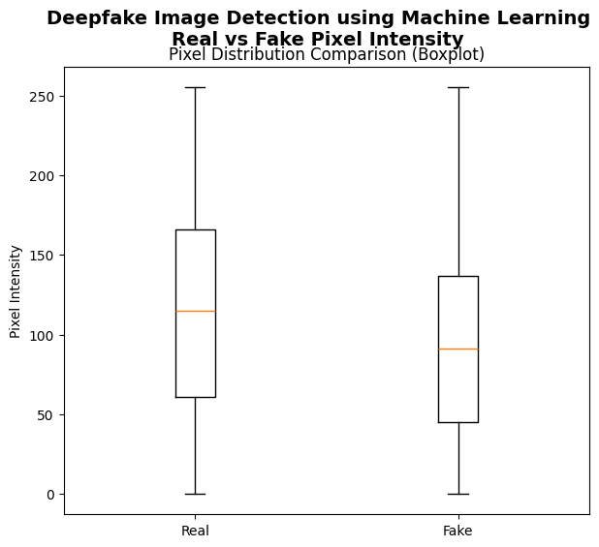
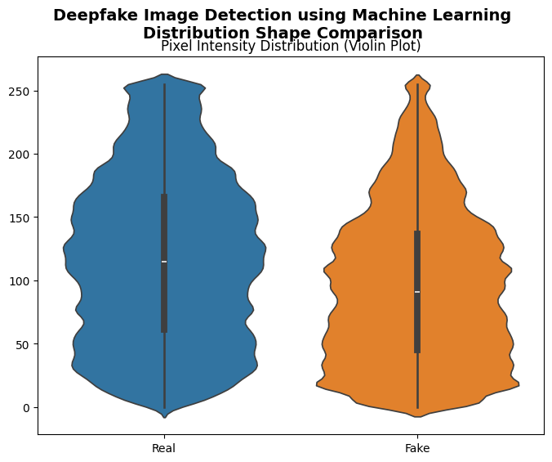
  ## BOXPLOT ##
plt.boxplot([real_pixels, fake_pixels], labels=['Real', 'Fake'])
plt.title("Pixel Distribution Comparison (Boxplot)")
    ## VIOLIN PLOT ##
sns.violinplot(data=[real_pixels, fake_pixels])
plt.xticks([0, 1], ['Real', 'Fake'])
plt.title("Pixel Intensity Distribution (Violin Plot)")
Fake images tend to have lower median pixel intensity compared to real images. Variability and range of pixel intensities are somewhat comparable between real and fake images.

Slide 36
Comparative Analysis and Best-Fit Model Selection

Slide 37
Model Performance Comparison
CNN
  High recall (0.944) and decent precision (0.842), Slightly lower overall accuracy (0.883) .
  Strong at identifying deepfake images correctly.
  Training time moderate (178 s), suitable for larger datasets.
PCA + Logistic Regression
  Fastest training (0.03 s) but lowest accuracy (0.801) and F1-score (0.801).
  Suitable for quick prototyping or small datasets.
  Limited in capturing complex image features; performs worst in detecting subtle deepfake artifacts.
SVM
  Highest accuracy (0.955), F1-score (0.955), and AUC (0.989).
  Strong precision (0.940) and recall (0.971), indicating reliable detection of both real and fake images.
  Longest training time (315 s), especially with high-dimensional feature space..

Slide 38
Best Fit Model is:-
Best-performing model: SVM (highest accuracy, F1, and AUC) for this study.
CNN is also effective, especially with raw images and automated feature learning, but slightly less accurate than SVM on these features.
PCA + Logistic Regression is fast and interpretable but not as accurate; suitable for preliminary analysis or low-resource settings.
For real-world deployment, SVM is recommended for statistical feature–based classification, while CNN can be used for end-to-end learning on raw images, possibly in a hybrid pipeline.

Slide 39
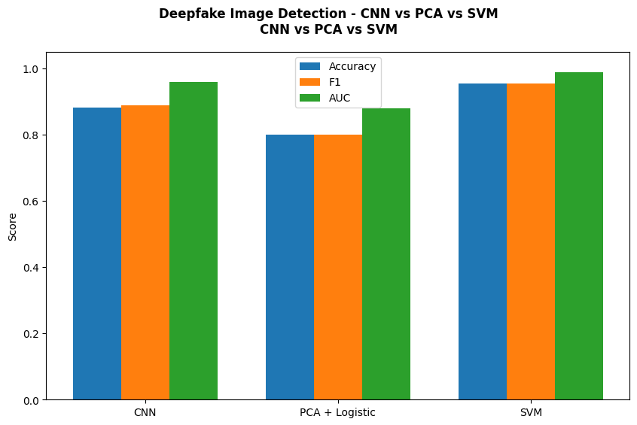
    ## BARPLOT OF COMPARISON ##
plt.bar(x-0.25, df_summary["Accuracy"], width=0.25, label="Accuracy")
plt.bar(x, df_summary["F1"], width=0.25, label="F1")
plt.bar(x+0.25, df_summary["AUC"], width=0.25, label="AUC")
plt.xticks(x, df_summary["Model"])
plt.ylim(0,1.05), plt.ylabel("Score")
Interpretation
The bar plot compares the performance of three models - CNN, PCA + Logistic, and SVM - for Deepfake Image Detection based on Accuracy, F1 score, and AUC.
All three models have comparable Accuracy.
SVM seems to have slightly better or comparable metrics across Accuracy, F1, and AUC.
PCA + Logistic has a relatively lower F1 score compared to the others.
CNN performs decently compared to SVM and PCA + Logistic.
SVM seems to be best fit model among the others.

Slide 40
How This Study Stands Different Among the Previous Ones??
  Our study systematically compared both classical ML (PCA + Logistic, SVM) and deep learning (CNN) approaches on the same dataset to evaluate their relative performance comprehensively.
  This study applies dimensionality reduction (PCA) before logistic regression, demonstrating how preprocessing impacts performance.
  This combination allows understanding the trade-off between training speed and model accuracy, which previous studies often did not quantify clearly.
  Most earlier studies reported only accuracy. Here, we also report precision, recall, F1-score, and AUC, providing a deeper understanding of model performance, especially in datasets with potential class imbalance.
  This study emphasizes trade-offs between accuracy, computational cost, and detection reliability.
  By comparing models across different criteria, the study offers guidance for selecting models based on specific application needs (e.g., time-critical deployment vs. high-accuracy detection), which is rarely addressed in prior research.

Slide 41
Final Conclusion
This study aimed to compare the performances of different machine learning and deep learning models for the task of deepfake image detection. Three models—CNN, PCA + Logistic Regression, and SVM—were evaluated on the same dataset using multiple performance metrics including accuracy, precision, recall, F1-score, AUC, and training time. Also by comparing multiple models on the same dataset with comprehensive metrics, this research highlights the importance of evaluating both performance and computational efficiency in model selection. The results also provide a roadmap for choosing appropriate models based on specific application requirements, marking a significant improvement over earlier studies that focused on a single model type.

Slide 42
key Findings & Results
1. Model Performance:
  SVM: Highest accuracy (95.47%) & F1-score (95.55%), AUC 0.9888 – excellent overall classification and strong discrimination ability.
  CNN: Accuracy 88.33%, very high recall (94.41%), balanced precision & F1-score – effective at detecting true positive cases, important for sensitive applications & large datasets.
  PCA + Logistic Regression: Accuracy 80.14%, extremely fast training (0.03 s) – suitable for rapid, lightweight implementations with limited computational resources.
2. Trade-offs Observed:
  Accuracy vs. Training Time: SVM gives maximum accuracy but takes longer (315 s); CNN offers a middle ground (178 s); PCA+Logistic is fastest but less accurate.
  Precision vs. Recall: CNN favours recall over precision (better positive detection), SVM maintains a strong balance.
3. Practical Implications:
Depending on the application, model selection can prioritize either speed or accuracy. For real-time or resource-constrained systems, PCA + Logistic may be preferable. For maximum detection reliability, SVM is the best choice, and CNN offers a good middle ground.

Slide 43
REFERENCES

Slide 44
Goodfellow, I., Pouget-Abadie, J., Mirza, M., Xu, B., Warde-Farley, D., Ozair, S., Courville, A., & Bengio, Y., “Generative Adversarial Nets,” Advances in Neural Information Processing Systems (NeurIPS), 2014.
Korshunov, P., & Marcel, S., “DeepFakes: a New Threat to Face Recognition? Assessment and Detection,” arXiv preprint arXiv:1812.08685, 2018.
Agarwal, S., Farid, H., Gu, Y., He, M., Nagano, K., & Li, H., “Detecting Deep-Fake Videos from Appearance and Behavior,” arXiv preprint arXiv:2004.02752, 2020.
Afchar, D., Nozick, V., Yamagishi, J., & Echizen, I., “MesoNet: a Compact Facial Video Forgery Detection Network,” IEEE International Workshop on Information Forensics and Security (WIFS), 2018.
Zhang, X., Zhang, Y., Li, L., & Wu, X., “Detecting and Exposing DeepFake Videos by Analyzing Eye Blinking Patterns,” IEEE International Conference on Multimedia & Expo Workshops (ICMEW), 2019.
Li, Y., Chang, M. C., & Lyu, S., “In Ictu Oculi: Exposing AI Generated Fake Faces,” arXiv preprint arXiv:1806.05677, 2018.
Nguyen, H. H., Yamagishi, J., & Echizen, I., “Use of a Capsule Network to Detect Fake Images and Videos,” arXiv preprint arXiv:1910.12467, 2019.
Korshunov, P., & Marcel, S., “Detection of Video Face Manipulation Using Temporal and Spatial Features,” IEEE Transactions on Information Forensics and Security, 2019.
Afchar, D., Nozick, V., & Echizen, I., “Deep Learning for DeepFakes Detection,” IEEE International Conference on Acoustics, Speech, and Signal Processing (ICASSP), 2018.
Jain, A. K., Ross, A., & Nandakumar, K., Introduction to Biometrics, Springer, 2011.
Cortes, C., & Vapnik, V., “Support-Vector Networks,” Machine Learning, vol. 20, pp. 273–297, 1995.
Bishop, C. M., Pattern Recognition and Machine Learning, Springer, 2006.
He, K., Zhang, X., Ren, S., & Sun, J., “Deep Residual Learning for Image Recognition,” IEEE Conference on Computer Vision and Pattern Recognition (CVPR), 2016.
Saikia, P., Dholaria, D., Yadav, P., Patel, V., & Roy, M. (2022). A Hybrid CNN-LSTM Model for Video Deepfake Detection by Leveraging Optical Flow Features. arXiv preprint arXiv:2208.00788.
Nagarhalli, T. P., Save, A., Patil, S., & Aswalekar, U. (2024). A Comprehensive Review of Deepfake and its Detection Techniques.
Rossler, A., Cozzolino, D., Verdoliva, L., Riess, C., Thies, J., & Nießner, M. (2019). FaceForensics++: Learning to detect manipulated facial images. In Proceedings of the IEEE/CVF International Conference on Computer Vision (ICCV), 1–11.

Slide 45

A Quick Demo to User Interface

Slide 46
Thank
You
Presented by:-
Disha .R. Sojrani

